Slide 1
Drive user engagement across all your devices with Microsoft Graph
Notes:
DEMO RESOURCES: https://github.com/Microsoft/InsiderDevTour18-graph

Slide 2
Microsoft Graph
What is it and why is it important for you?
Getting started and tools
API highlights
Cross-device and Timeline

Slide 3
Microsoft Graph
What is it and why is it important for you?
Getting started and tools
API highlights
Cross-device and Timeline

Slide 4
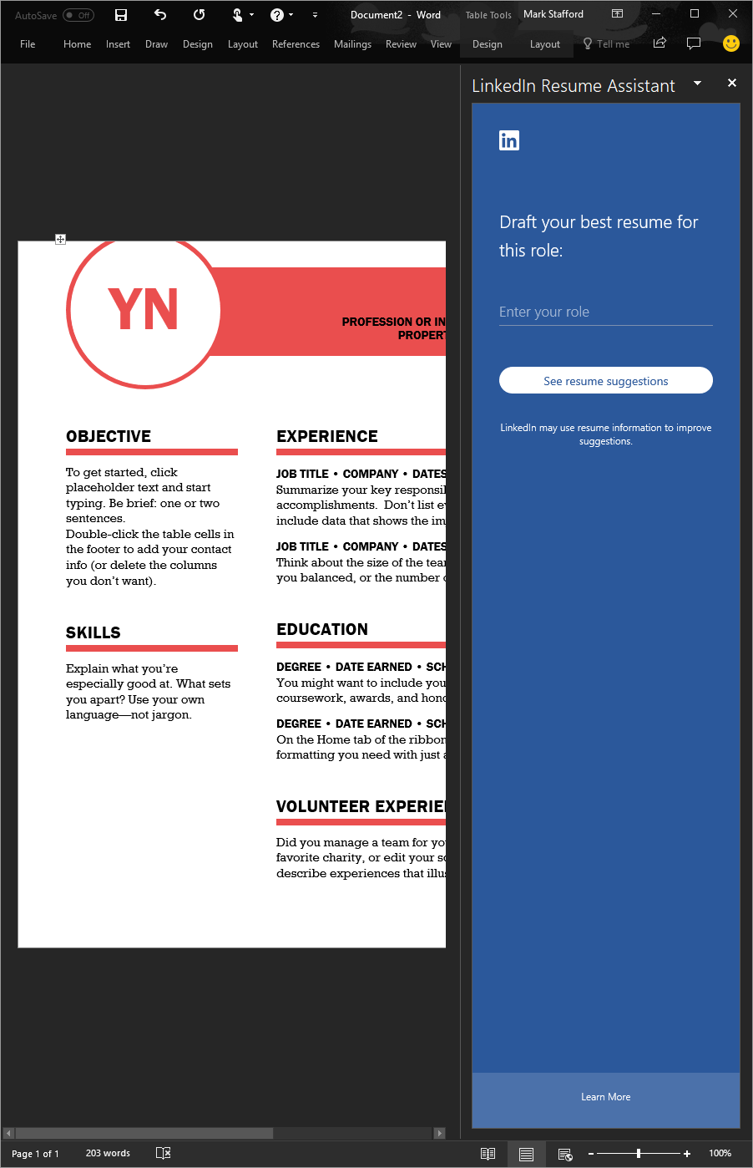
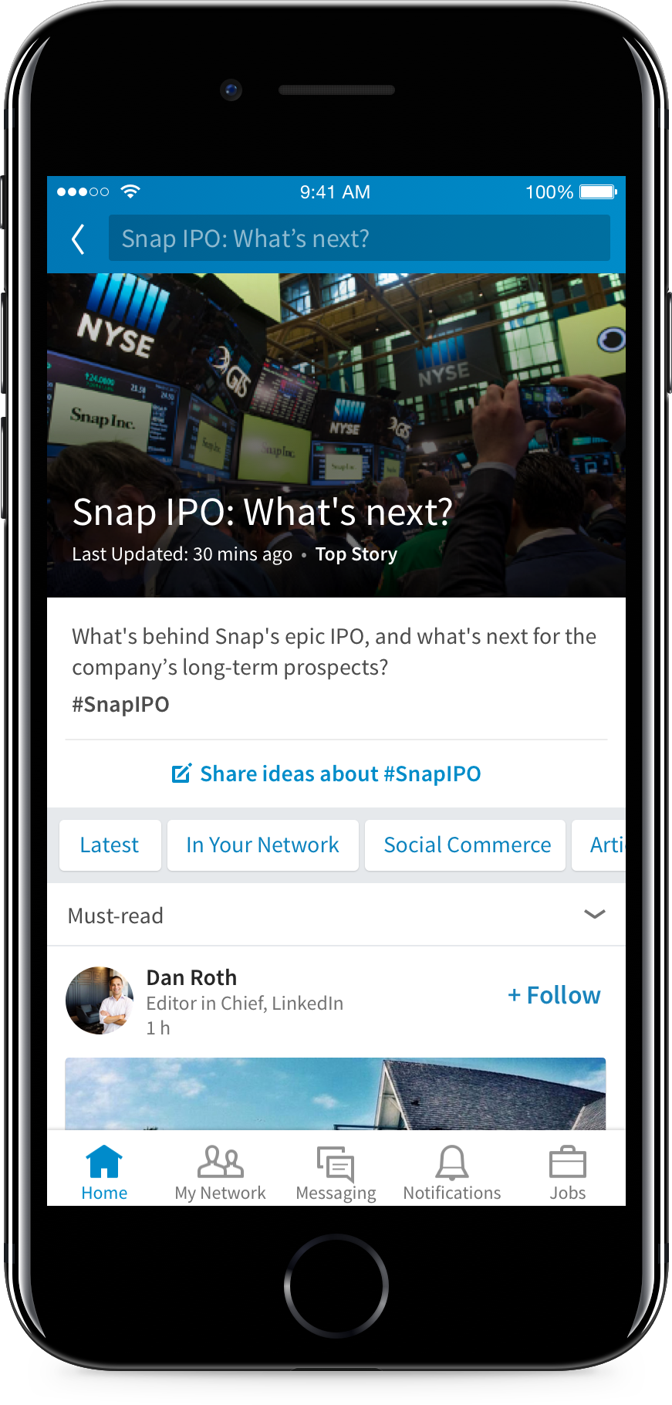
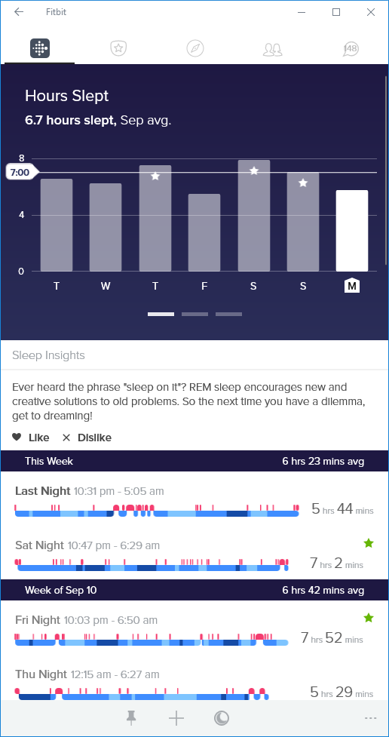
Constellations of data
1. Intentional, static
2. Conversations, feeds
3. “Ambient” data
Notes:
Set the foundation: Constellations of data, everywhere
Intentional / static: things like profile, office location, org chart
Conversations / feeds: outlook messages, teams conversations, bot interactions
Ambient: document usage, time spent on tasks, collaborations
Ambient data is layered by insights to make this intelligence easily accessible to developers

Slide 5
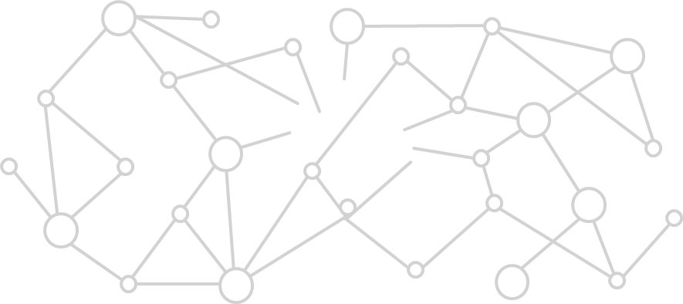
Microsoft Graph is all about you
If you or your customers are part of the millions of users that are using Microsoft cloud services, then Microsoft Graph is the fabric of all your data
It all starts with /me
Notes:
How do I get my data into the cloud?
Why does this matter to me: Microsoft Group is all about you, since we build connections on your data – making your constellation work for you
Data about you, your usage about ms services, consumer or commercial clouds
No need to “add” data in cloud, MS customers already have data in Graph

Slide 6
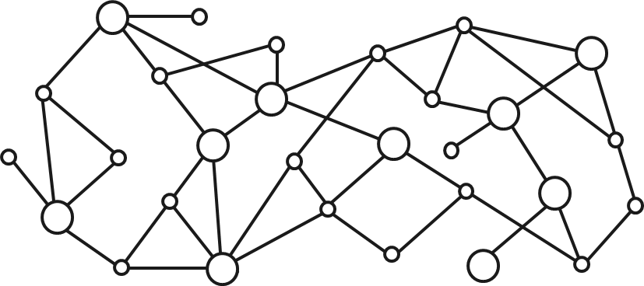
Gateway to your data in the Microsoft cloud
Your app
Web Apps
Device & Native
Apps
Bots
Background
processes
1
Gateway
Microsoft Graph
Office 365
Windows 10
Enterprise Mobility + Security
Your or your customer’s data
Microsoft identity
Rich content
Deep insights
Real-time updates
Notes:
Your App: app can be anything, UWP, web site, device app, bot or even azure web hooks
What type of data do you get out of it?
Identity of users (including auth)
Rich context for all the things users are doing
Insights around all the intelligence
Realtime updates whether it is interactions or content usage

Slide 7
Microsoft Graph
graph.microsoft.com
ALL
ALL
ONE
your data across Microsoft 365
Types of users
way to access it all
Office 365
Windows 10
EMS
Corporate (@contoso.com)
Consumer (@outlook.com)
One endpoint
One auth key
One set of docs
One SDK
Notes:
In Summary:
Setup the value of this gateway: 1-everything – token, call pattern and more – and all the things – users, devices, and so on

Slide 8
Microsoft Graph
What is it and why is it important for you?
Getting started and tools
API highlights
Cross-device and Timeline

Slide 9
Developing with Microsoft Graph
graph.microsoft.com
TRY
LEARN
DEVELOP
Graph Explorer and quick starts
With docs and API reference
With SDKs, samples, and tooling

Slide 10
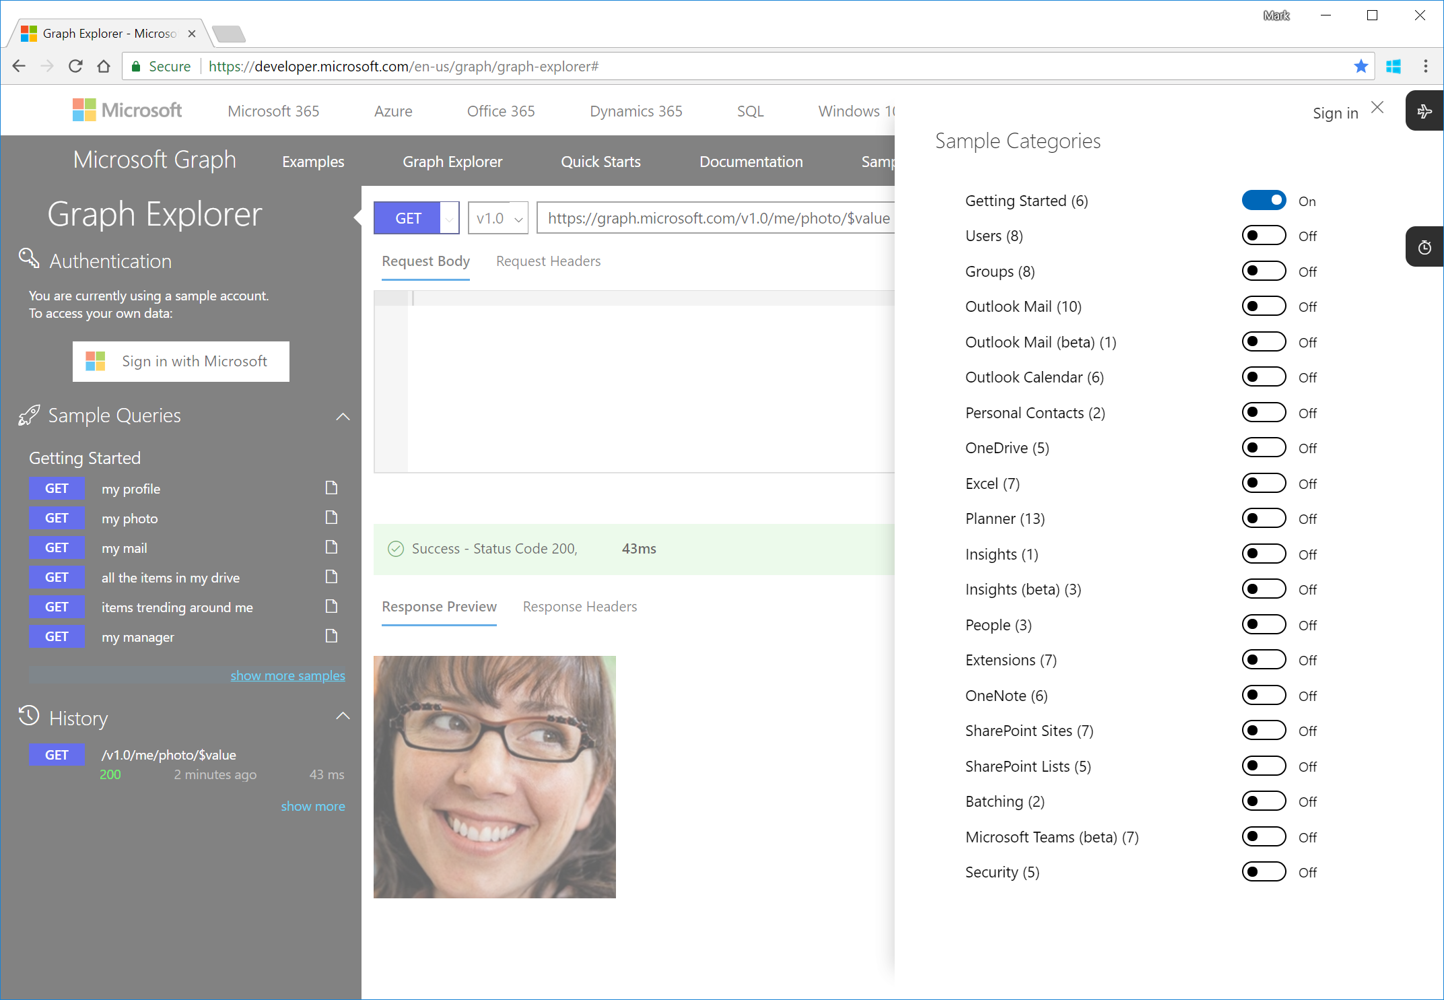
TIP: Graph Explorer is your best friend
Quickly try requests
from your browser
Supported accounts:
Demo (commercial)
Consumer (@outlook.com)
Commercial (@fabrikam.com)
And it’s open source
Caution: if you sign in, Graph Explorer can actually create/modify data
Notes:
Graph Explorer is a customized HTTP request tool that makes it really easy to discover and execute queries.
Along the left nav is a series of categorized requests, and you can click on “show more samples” to add or remove categories.
In the main window, you compose your request and view the response. When you type in the URL bar, Graph Explorer will suggest some query options for you to choose, but really you can issue any query against Graph, even if the autocompletion doesn’t suggest it.
Note that if you haven’t explicitly logged in, Graph Explorer is logged in with a demo account and will not allow data modification.
Fortunately, Graph Explorer supports logging in with a work or personal account, at which point you can modify data – but remember, this is the real deal! Whatever you do through the API is actually happening.

Slide 11
Demo
Graph Explorer
Notes:
During the website calendar demo, you can help tell the story by having one of your colleagues (in the audience) pretend to send you a meeting invite for the meeting. Have your colleague hold a phone – people will not be able to see the screen, but it looks more interactive / realistic.

Slide 12
Microsoft Graph
What is it and why is it important for you?
Getting started and tools
API highlights
Cross-device and Timeline

Slide 13
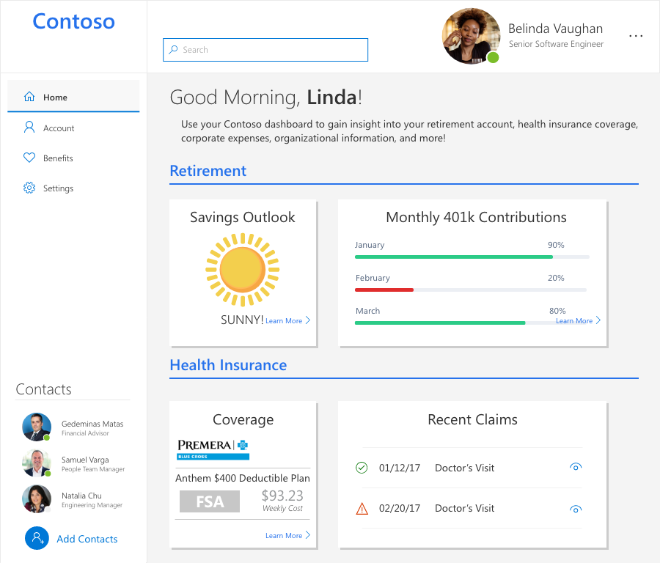
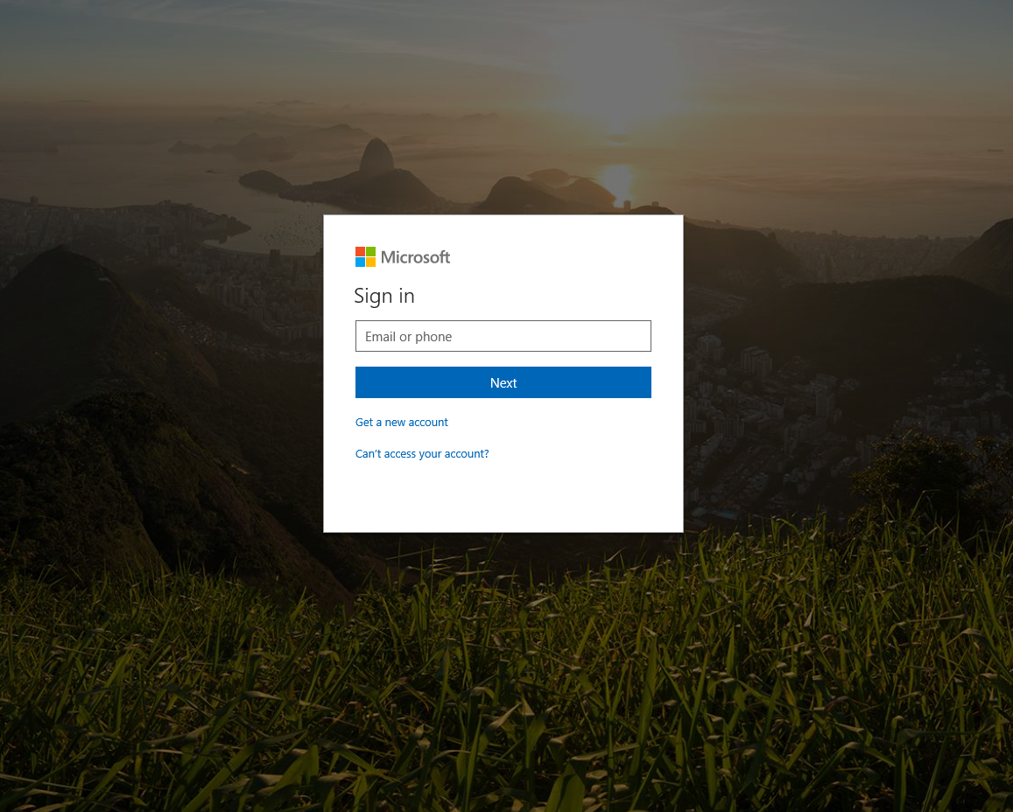

Leverage Microsoft identity
/me/photo/$value
Yina Arenas
Principal PM
New login from this device
/security/alerts
Yina!
/me
/me/people

Slide 14
Approval workflows | document approval
SELECT DOCUMENT
BUILD MESSAGE
SEND MESSAGE
Get documents on OneDrive
Get use photo
Send message
GET /drives/{id}/root/children
POST /me/photo/$value
POST /me/sendMail
Select file
Get thumbnail
GET /drives/{id}/items/{id} /thumbnail
GET /drives/{id}/items/{id}
Get thumbnail
Get sharing link
GET /drives/{id}/items/{id} /thumbnail
POST /me/drive/items/{itemId}/createLink
Notes:
This is an example of how you would use the APIs to build out a document approval flow:
Get the documents and select a file and thumbnail
Buid a message from the user (name email) include the thumbnail and share link of the document
Send the message!

Slide 15
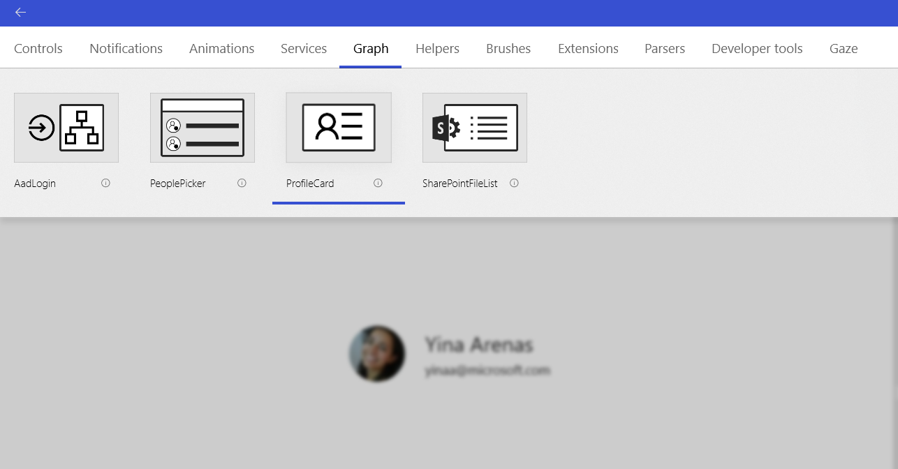
New UWP controls for Microsoft Graph
https://aka.ms/windowsToolkit

Slide 16
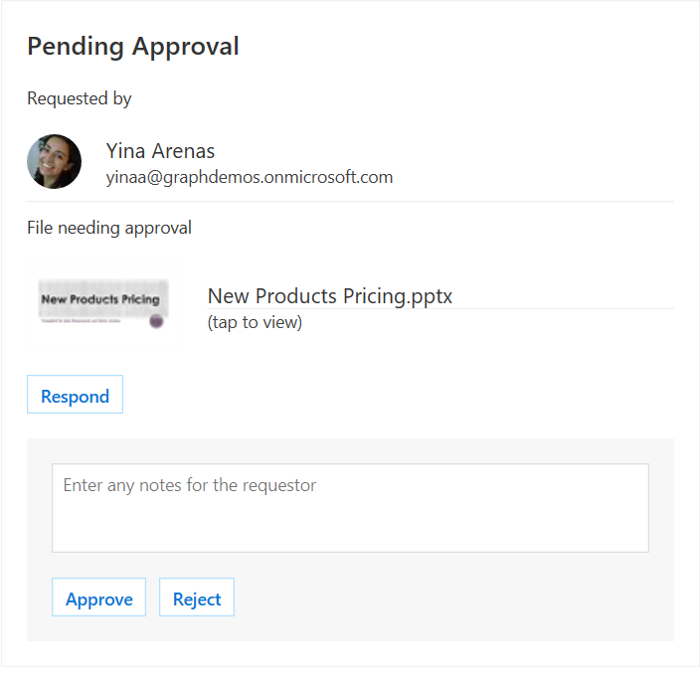
Adaptive cards
JSON based schema
Easy to author
Render in:
Bot Framework
Cortana
Outlook
Microsoft Teams
Skype
Windows timeline
Windows notifications

Slide 17
Demo
Adaptive cards

Slide 18
Microsoft Graph
What is it and why is it important for you?
Getting started and tools
API highlights
Cross-device and Timeline

Slide 19
Microsoft graph activities APIs and Microsoft graph devices APIs Activities and cross device experiences
Activities
Get you app activities in the Windows Timeline
Let customers pick up where they leave off
Feed is synchronized effortlessly across devices & platforms
Activities API
List, create, replace, delete activities
Devices
Discover and connect to user's devices
Remotely launch apps on those devices
Send messages to your apps on those devices
Device API
List devices
Send commands
Get command status
Notes:
The activity feed API let's you read & write activities for your app to provide a synchronized view of users important tasks across all your app surfaces
But activities also power a number of new Microsoft experiences which will also help drive users back into your app
Publish activities & history items from web apps easily using MSGraph
Activities stand out with rich visuals using the Adaptive Card schema
Leverage Microsoft experiences like Timeline to drive more app engagement
Display activities in your own app, to keep user tasks in sync everywhere

Slide 20
Microsoft graph activities APIs
Request
PUT https://graph.microsoft.com/v1.0/me/activities/uniqueAppIdInContext HTTP/1.1
{ "appActivityId": "uniqueIdInAppContext",
"activitySourceHost": "https://myappsuniquedomain.com",
"appDisplayName": "Graph Demo",
"activationUrl": "https://developer.microsoft.com/en-us/graph/graph-explorer",
"visualElements": {"displayText": "Microsoft Graph Sample User Activity"},
"historyItems": [
{
"userTimezone": "America/Los Angeles",
"startedDateTime": "2018-04-22T20:40:04.345Z",
"lastActiveDateTime": "2018-04-23T21:00:24.345Z"
}
]
}
Notes:
You can upsert an activity and a history item in a single Graph request using a technique called deep insert so you don't have to wait for a response to return the activity id in order to associate a history item to it
Here's the minimum info you'll need:
appActivityId
provide a unique id for the activity in the context of your app, make sure you take cross-device scenarios into account
activitySourceHost
supply a URL pointing to a domain you own which represents the cross-platform identity of your app
this either points to a JSON file you host or a profile you can manage in Windows Dev Center
appDisplayName & displayText
so users can recognize an activity is from your app and they can see a brief description of the activity itself
activationURL
A deep link to your app so a user can resume the activity, you can also include a fallbackURL to use if the user doesn't have your app installed if that make sense for your activity
historyItems
You don't have to publish history items to use activities in your app, but if you want them to show up in Timeline you do
Each history item captures the duration of user engagement as a startTime & lastActiveTime

Slide 21
Demo
Activities in the Windows timeline

Slide 22


graph.microsoft.com
Get started today!
Twitter
#MicrosoftGraph
GitHub
/MicrosoftGraph
StackOverflow
[MicrosoftGraph]
Notes:
Office 365 and its 100M MAU create an incredible opportunity for developers to ring their innovations to the masses. Microsoft Graph is the API to millions of organizations, and the foundation for building intelligent business process.

Slide 23
aka.ms/insiderdevtour-labs
Build a graph app from starter kits
Manage files and content with Graph API
Write user activities with adaptive cards

